Slide 1

Autonomous Navigation in Confined Waters - A COLREGs Rule 9 Compliant Framework
Peter Nicholas Hansen, Thomas T. Enevoldsen, Dimitrios Papageorgiou, Mogens Blanke
Automation and Control Group, DTU Electro
Notes:
Hello, my name is Nicholas Hansen, I’m a PhD student at the Automation and Control Group here at DTU.\
Today I would like to talk our work titled: Autonomous Navigation in Confined Waters – a COLREGs rule 9 compliant Framework.
This work was done in collabortion with my collegues, PhD Student Thomas Enevoldsen, Assistant Prof. Dimitrios Papageorgiou and my supervisor Prof. Mogens Blanke

Slide 2
Presentation Outline
Motivation
Overview of relevant COLREGs Rules
Proposed Framework
Results
Conclusions and future work
Notes:
In this talk, I will cover
The motivation – why are we doing this, and what would it benefit
I’ll give an overview of some of the relevant COLREG rules
I’ll detail the proposed framework that we developed
I’ll share some simulation results with you
And lastly we’ll talk about some conclusions and suggestions for future work

Slide 3
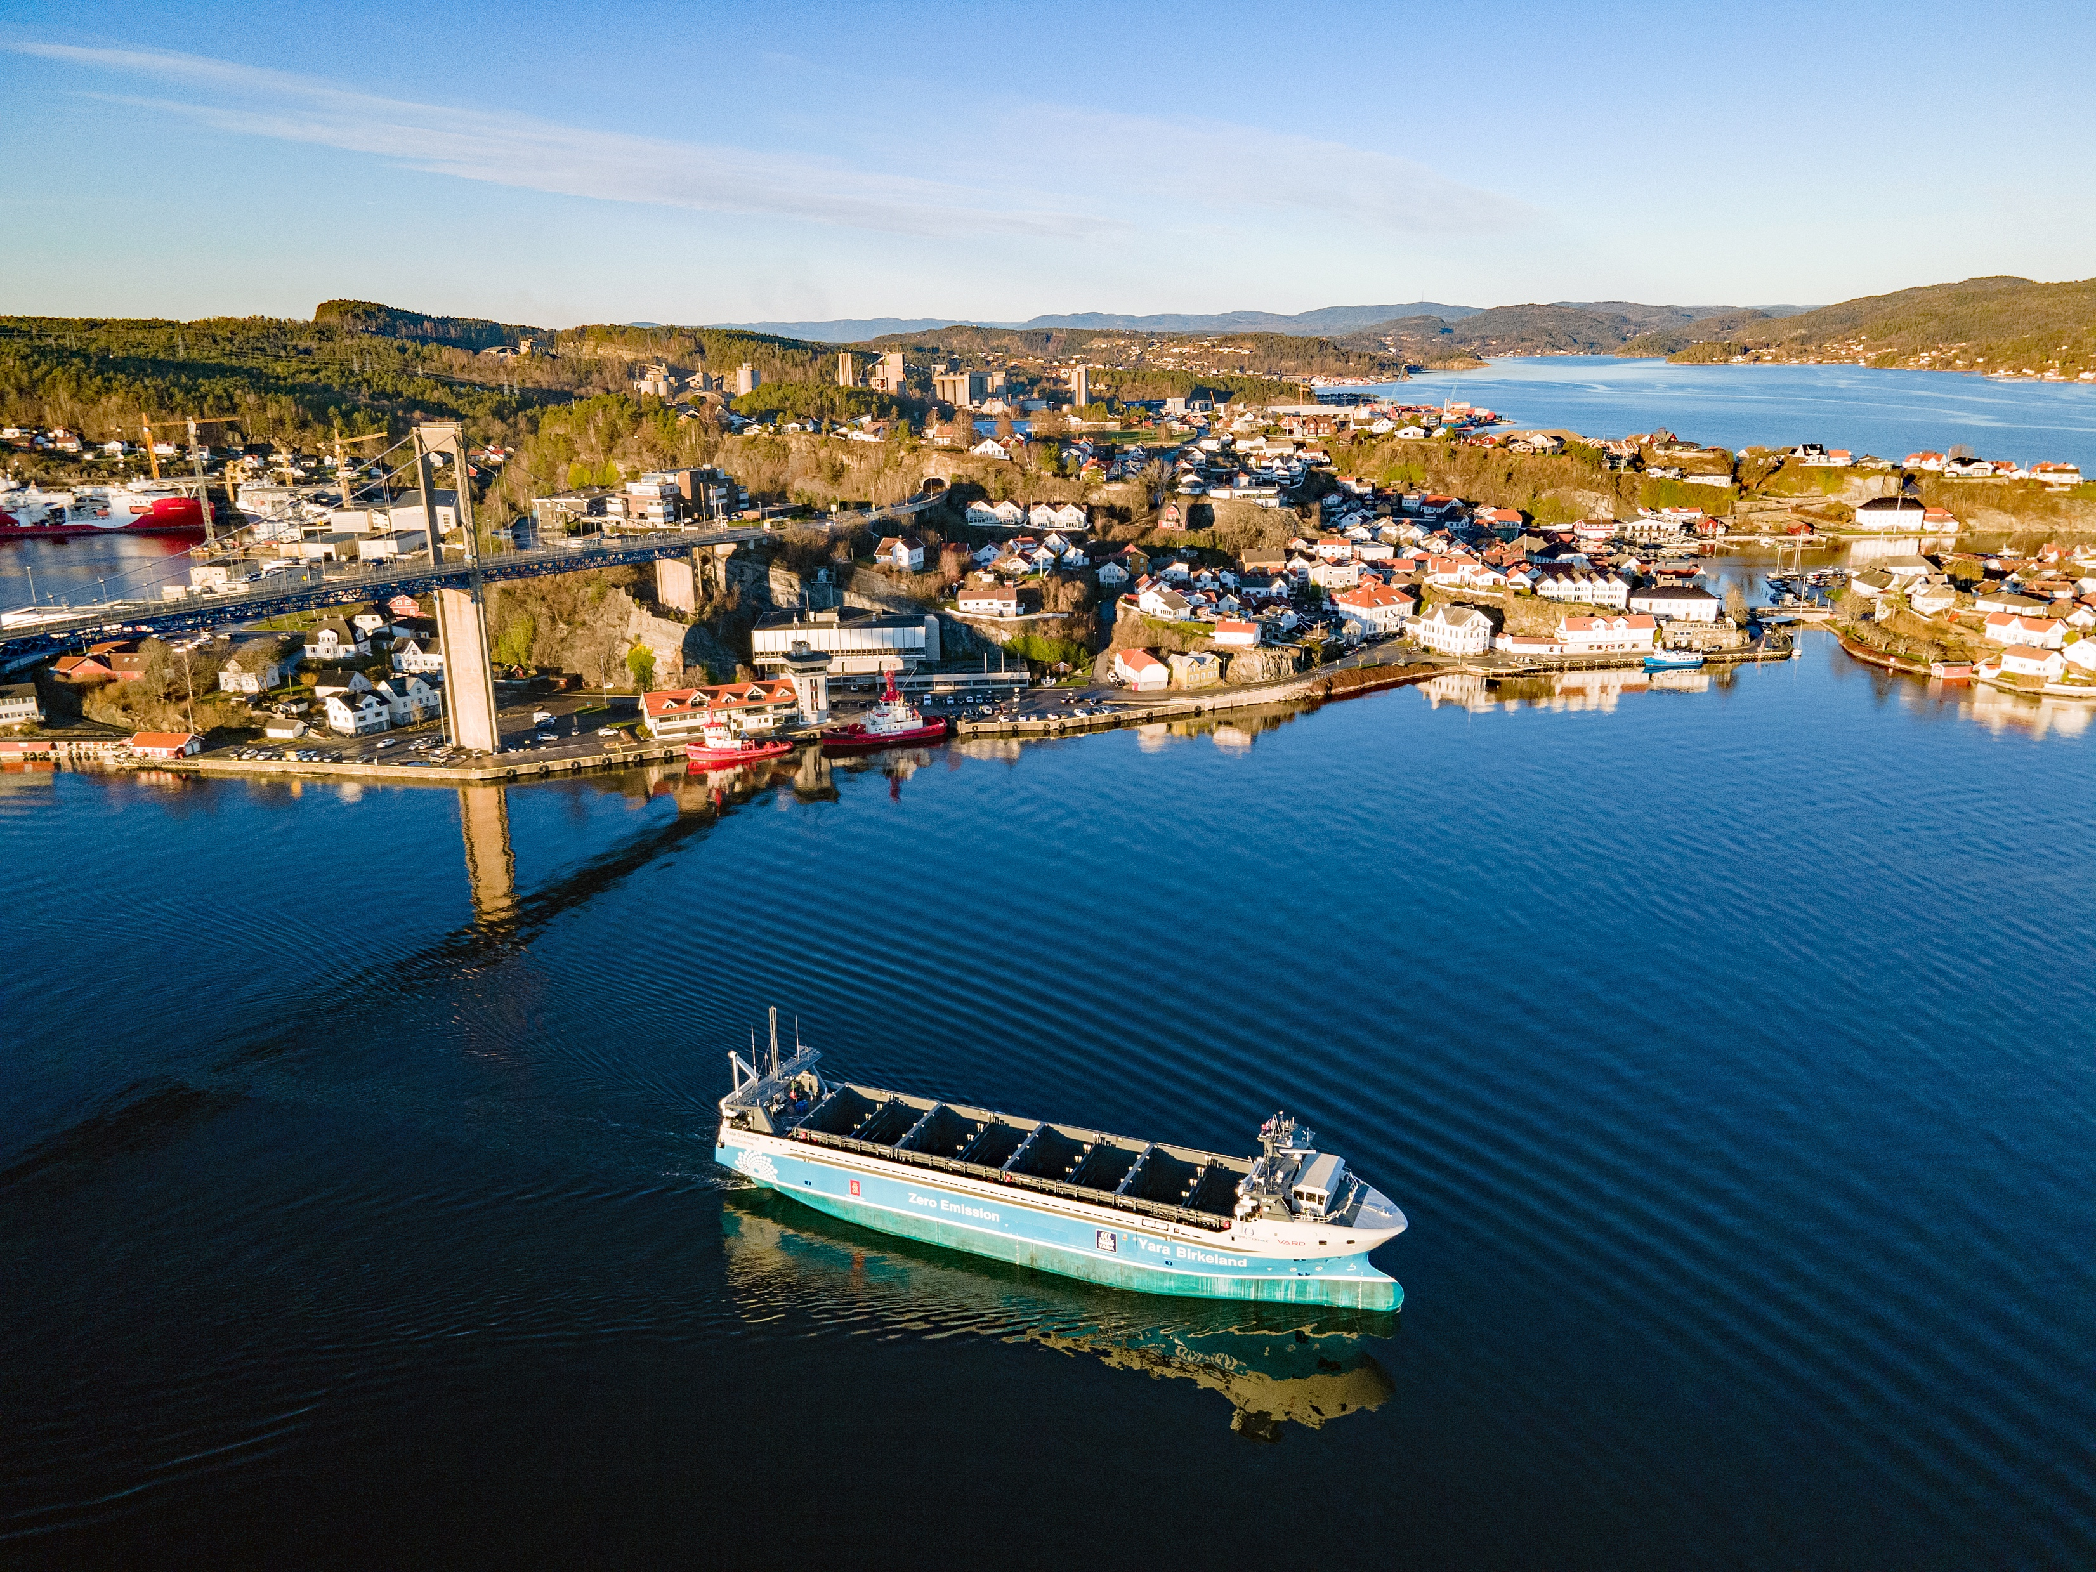
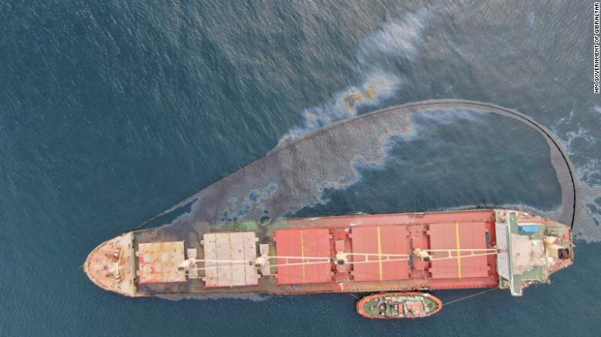
Motivation
Why do we want autonomy?
Transport
Cargo (Yara birkeland)
Passenger
Safety
LNG Bulk carrirer OS 35 crashed with another vessel (29/08/2022)
Copyright © 2004 – 2022 Yara International ASA All rights reserved
https://www.cnn.com/2022/09/01/europe/gibraltar-cargo-ship-vessel-collision-intl/index.html
Notes:
So why do we want to pursue autonomy for marine vessels?
Transport purpose:
Cargo: the fully electrified Yarabirkeland will remove a claimed 40.000 diesel trucks from the roads of norway each year
Passengers: This could enable more frequent traffic (or even ride-hailing) to smaller island populations, given a more flexible connetion to the mainland, thereby increasing the quality of life of inhabitants of those islands.
2) Safety:
- Automation could be deployed onboard existing vessels as a help to the navigation crew, even enabling “temporarily unattended bridge” during night time – just like automation in the engine room has enabled the engine crew to avoid working night-shifts.
As an example – just a couple of weeks ago, two vessels collided of the coast of gibraltar, resulting in the Bulk carrirer OS 35 now sitting on the ocean floor, leaking fossile fuel into the ocean

Slide 4
COLREGs Rules
Rule 3 ”Vessel constrained by her draught”:
“A power-driven vessel which, because of her draught in relation to available depth and width of navigable water, is severely restricted in her ability to deviate from the course she is following.”
Rules 13-15: Overtaking, head-on & crossing
Illustration taken from [1]
[1] Enevoldsen, T.T. and Galeazzi, R. (2021). Grounding-aware RRT* for Path Planning and Safe Navigation of Marine Crafts in Confined Waters. IFAC-PapersOnLine, 54(16), 195–201.
Notes:
First, let me give a brief overview of some of the relevant COLREG rules:
Rule 3 - this rule specifies when a vessel is ”constrained by her draught”: namely when she is “severely restrictied in her ability to deviate from her course”
Rules 13-15 – these rules dictate the responsibilities of each vessel in the normal situations, overtaking, head-on and crossing, as illustrated in the figure

Slide 5
COLREGs Rule 9
Rule 9 dictates that [2]:
(a) “A vessel proceeding along the course of a narrow channel or fairway shall keep as near to the outer limit or the channel or fairway which lies on her starboard side as is safe and practicable.”
(b) ”A vessel of less than 20 m in length or a sailing vessel shall not impede the passage of a vessel which can safely navigate only within a narrow channel or fairway.”
(d) “A vessel shall not cross a narrow channel of fairway if such crossing impedes the passage of a vessel which can safely navigate only within such channel or fairway.”
[2] IMO (1972). Convention on the international regulations for preventing collisions at sea, 1972 (COLREGs).
Notes:
Now lets take a close look at Rule 9.
On the slide, I’ve inserted the relevant sections of the rule.
Rule 9 specifies the actions for vessels sailing along or crossing a “narrow channel or fairway” – I’ll get back to what these terms mean in the next slide.
Section a) instructs all vessel sailing along the channel to keep as close to the limit on her starboard side as possible
Sections b) and d) says that vessels crossing the channel “may not impede the passage of vessels” that can only navigate safely within the channel.
What does this mean for the autonomy stack?
This means that we must have algorithms that are able to evaluate a vessels ability to navigate in its surroundings, by extension, we need algorithms that estimate manoeuvrability

Slide 6
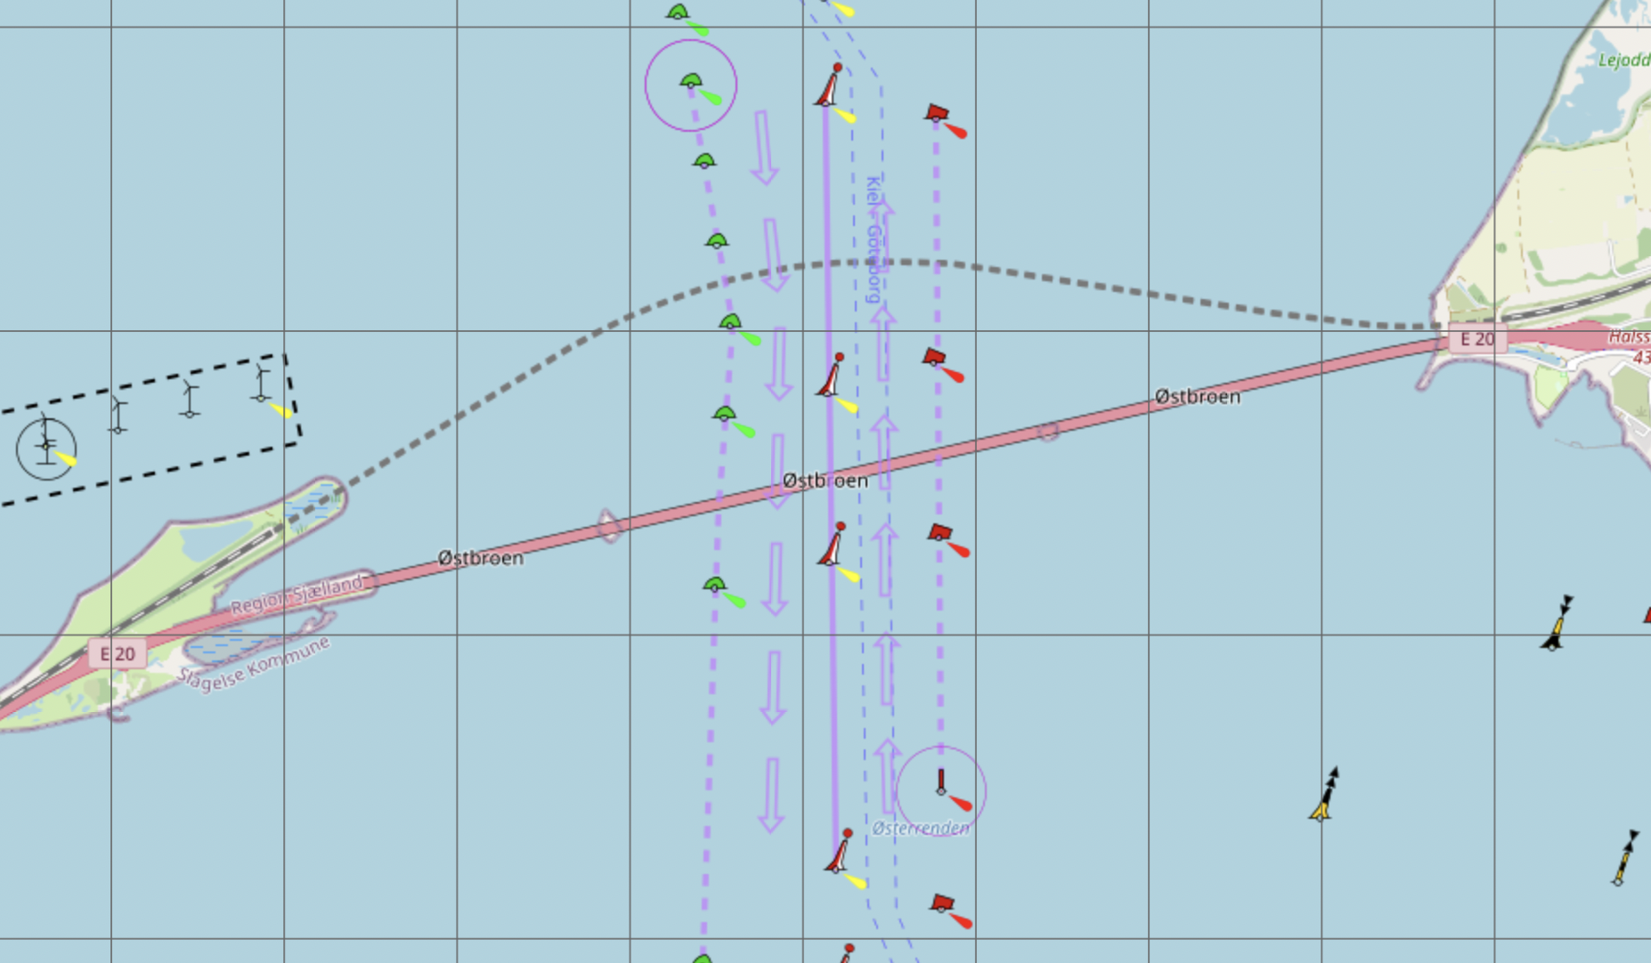
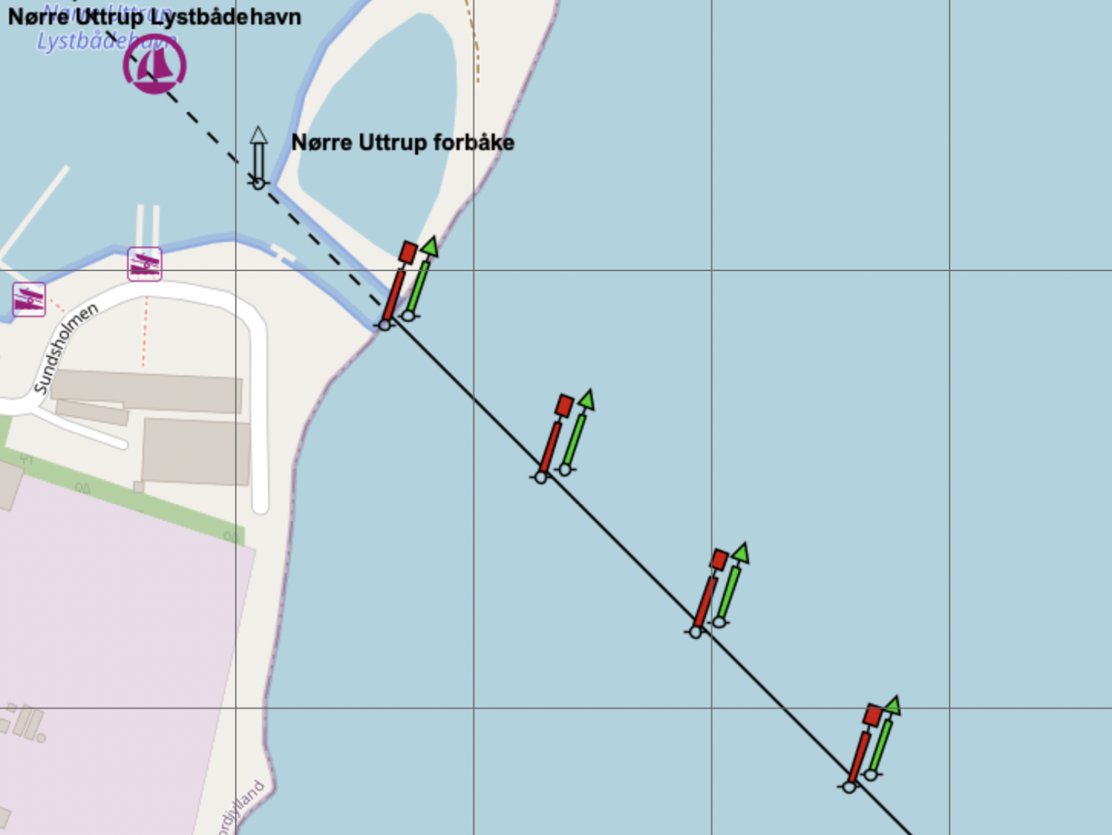
Definition of “Narrow Channel or Fairway”
Definitions [3]
Fairway: ”A navigable passage of water, or dredged channel maintained by the port authority marked by pecked lines on the chart, i.e. a deep water channel.”
Narrow channel: “The navigable width of water between lines of buoys”
[3] Cockcroft, A. and Lameijer, J. (2003). Guide to the Collision Avoidance Rules. Elsevier Science.
Notes:
So what is a narrow channel or fairway?
Cockcroft defines this as the “navigable passage of water, between pecked lines or buoys”.
I’ve added two examples here:
1) The left example illustrates the north and southbound traffic separation zone underneath the Great Belt bridge in Denmark, which is one of the main passageways for large vessel into the Baltic seas
2) The right example are the the entrace markings to the Nørre Uttrup harbour near Aalborg.
But this definition does not specify anything w.r.t. WHEN something is narrow?
As you can image the great belt traffic zone is much narrower for a large 300 meter container vessel, than the same area would be for say a 25 meter long tug boat
So when is something narrow?

Slide 7
Definition of “Narrow Channel or Fairway”
Cockcroft states [3]:
“The term ‘narrow channel’ is not easily defined”
“Passages approximately 2 miles wide have sometimes been considered narrow channels”
Narrow can be locally defined:
“seamen usually navigate the locality and the advice given by the Elder Brethren”
[3] Cockcroft, A. and Lameijer, J. (2003). Guide to the Collision Avoidance Rules. Elsevier Science.
Notes:
Well cockcroft specifically mentions that this is not easily defined, and this might be up to the courts to decide.
In fact, courts have rules that 2 mile wide passages have been deemed narrow.
Also, the term narrow can be locally defined, since sailors usually navigate based on local customs and habits, which is passed down from their “elder brethren”.
This means that certain areas can impose restrictions which, depending on the vessel, could restrict its manoeuvrability.

Slide 8
Manoeuvrability Assessment
Definition of restricted manoeuvrability (Based on [2]):
“The inability to deviate from a current course imposes a restriction on a vessel, and if such restrictions are due to environmental constraints, e.g. deep water channel, shallow water, etc., then a vessel can be considered restricted.”
[2] IMO (1972). Convention on the international regulations for preventing collisions at sea, 1972 (COLREGs).
Notes:
So here I state our definition of what we consider restricted manoeuvrability as “inability to devate from a current course due to environmental constraints”.

Slide 9
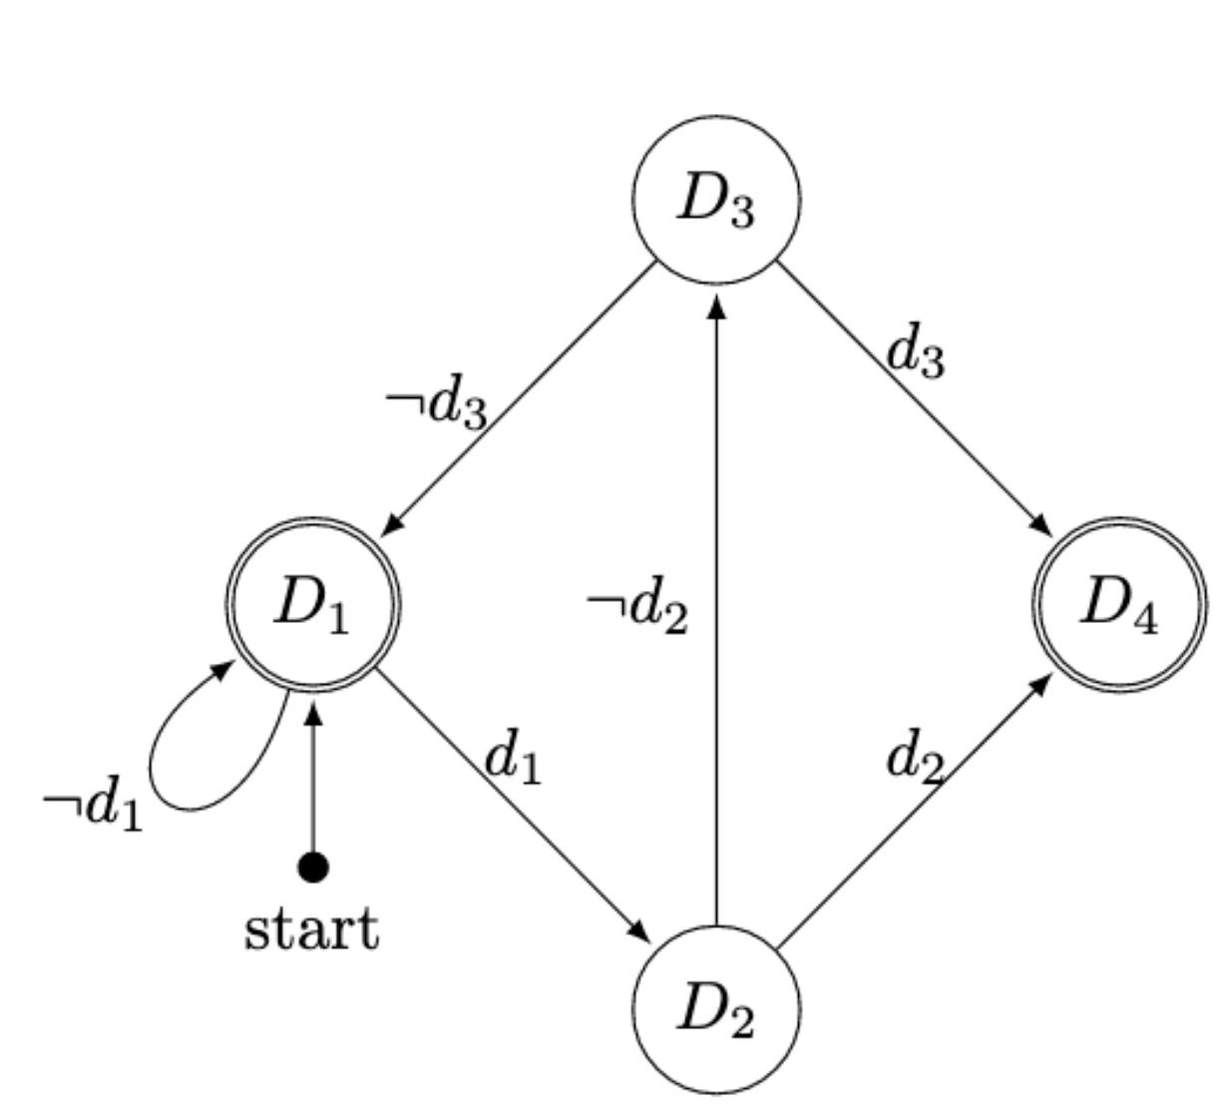
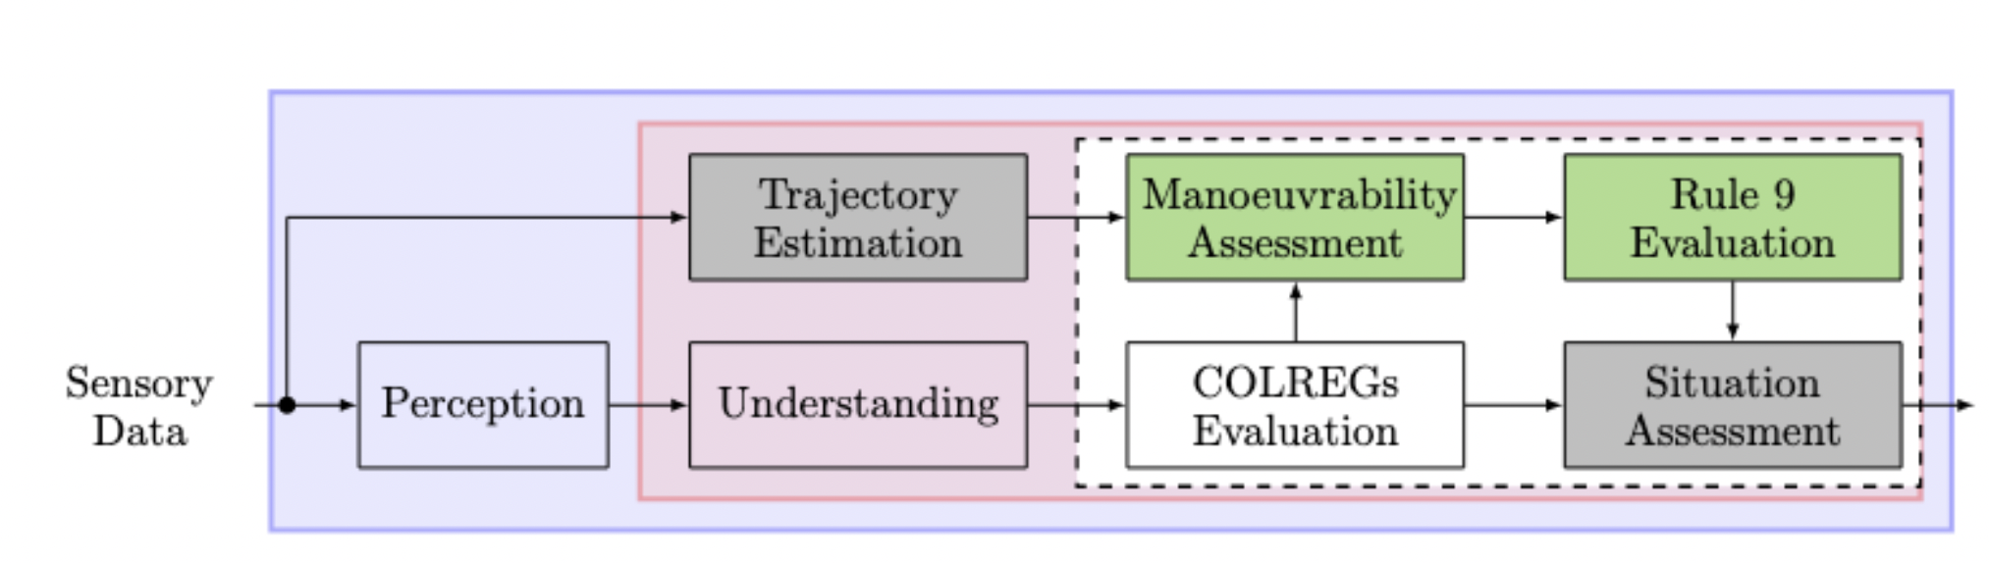
Framework
Automaton states
D₁: Check if TV needs to give way
D₂: Check if TV is reporting ”restricted manoeuvrability”
D₃: Evaluate manoeuvrability of TV.
D₄: Apply rule 9 → inversion of Give-way/Stand-on.
Notes:
Now I would like to introduce the framework that we developed.
The framework is based on a four-state automaton.
To put this new framework into context of the already existing system, it is embedded into the two green boxes in the figure below, namely maneuverability assessment and rule 9 evaluation.
Let me explain the other boxes a little bit.
To the far left we have “Perception” - this is a sensor-fusion algortihm, that all takes input from all sensory systems: this means camera, radar, AIS, etc., and this represents the autonomous vessels view of its surrounding environment.
The "Understanding" is a higher level abstraction, which is based on this perception information.
Upon this understanding of the environment a COLREGs evaluation is performed to give the current situation, such as overtaking, head-on, crossing and so on.
The trajectory estimation box in grey, is an algorithm, that is able to predict the future trajectory of any detected target, and provides this information to the system downstream.
Now, if the situation dictates that a target vessel must give way, then we perform a manoeuvrability assessment of that target.
This is done by:
First - Checking if the vessel is reporting "restricted manoeuvrability" in its AIS messages, and here we assume that the target is truthful .
If the target does not report restricted manoeuvrability, then we perform an assessment of that vessel - and I'll go over the details on the next slide.
If the assessment of the target is not restricted, then we transition back to state D1, and rules 13-15 apply as normal.
However, if the target is reporting restricted manoeuvrability, or our assessment is that the target is restricted, then we transition to state D4, and rule 9 is applied, inverting the responsibilities of the actors.

Slide 10
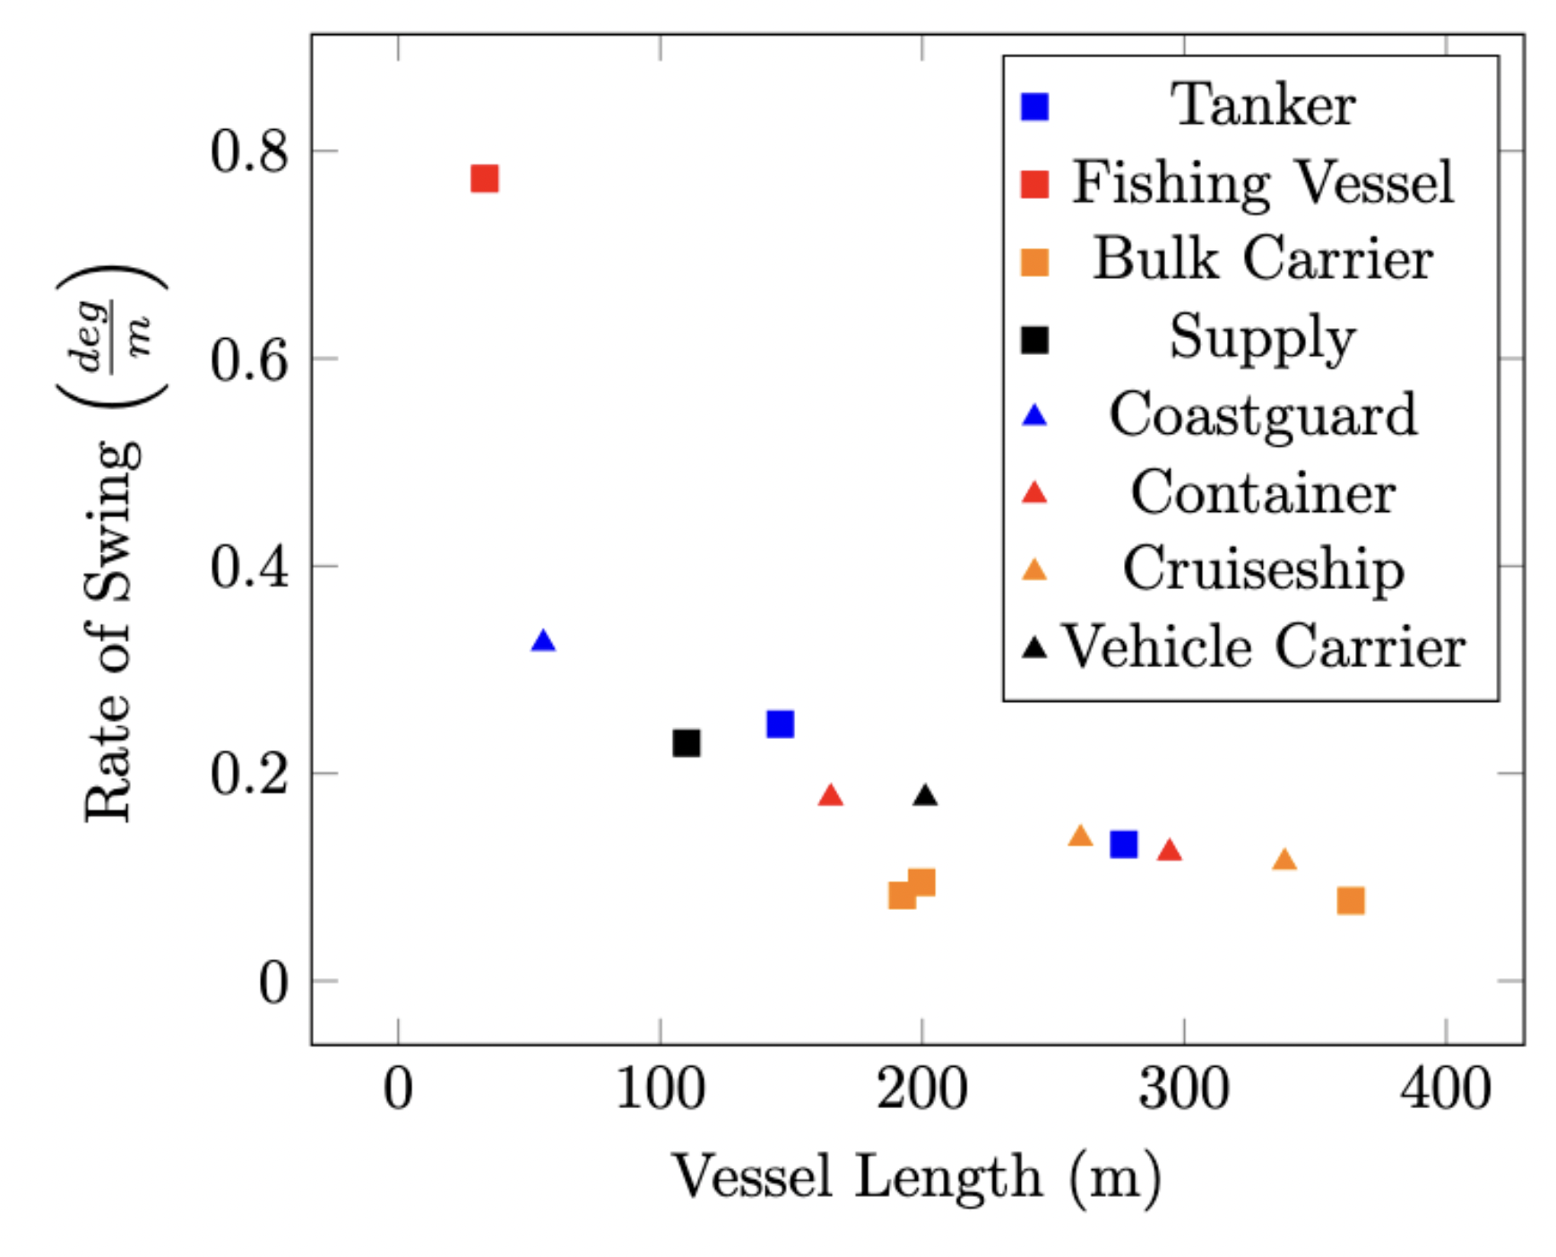
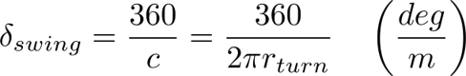
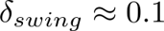
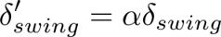
Manoeuvrability assessment
Define rate of swing
Calculate lower bound from 13 different turning tests [3]
Downscale rudder angle linearly
[4] IMO (2002). RESOLUTION MSC.137(76) - Standards for ship manoeuvrability. https://wwwcdn.imo.org/localresources/en/KnowledgeCentre/IndexofIMOResolutions/MSCResolutions/MSC.137(76).pdf
Notes:
So lets talk about how we assess manoeuvrability of a vessel.
We started by collecting the turning test data from 13 different vessels, that are used in training master mariners, and calculate the rate of swing, here denoted as delta subscript swing.
Rate of swing is the number of degress that the vessel would turn pr. meter traveled along the turning circle, and the results are shown in the plot on the right.
As we see from the plot, the fishing vessel is distrubting a somewhat linear trend, and maybe an exponential function could be fit to the data, however, we would need more data on short vessels to be sure.
So for simplicity and for a more conservative approach, we choose a fixed value of 0.1, which represents the lower bound of all the vessels.
However there is an issue here: turning tests are performed at maximum rudder angle, and expecting vessels to turn their rudders this much is not realistic.
Therefore we scale the rate of swing by a linear parameter alpha, to get into a more realistic rudder angle range,
We denote this scaled parameter as delta_subscript swing prime.
This linear scaling is most likely not valid, and there are certainly some non-linearities that are neglected, but this will serve for now for our use case.

Slide 11
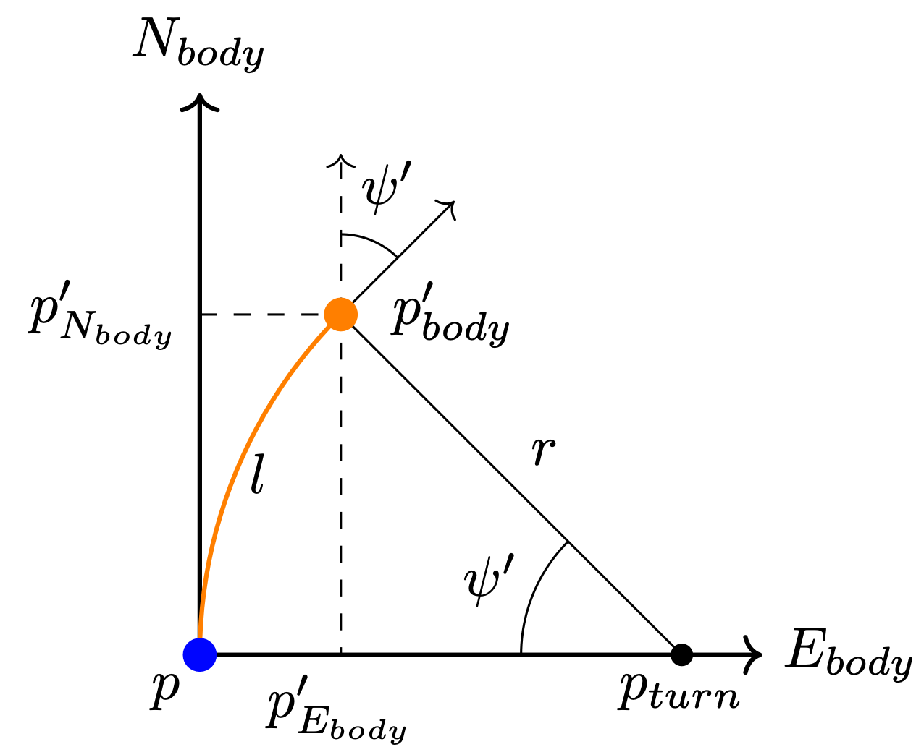
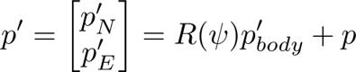
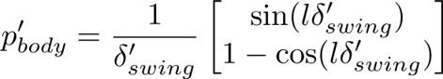
Manoeuvrability assessment
For each future timestep (up to TCPA)
Project vessel according to rate of swing
Draw the comfort zone ellipses around the projected positions
If any ellipse is not fully contained within the navigable water → restricted manoeuvrability
Notes:
Now that we have the a rate of swing, we can use this to project any vessel at a position P to a new position P-prime.
So for every future position P, we create two projections, assuming that the target initiates a turning manoevre to both starboard and to port, and travels a distance L along the circle.
For each of the projected points P-prime, we place an ellipse, which is to represent the comfort zone of the target.
If any points within this ellipse are not fully contained within navigable water for the given target vessel, it will be considered to have restricted manoeuvrability.

Slide 12
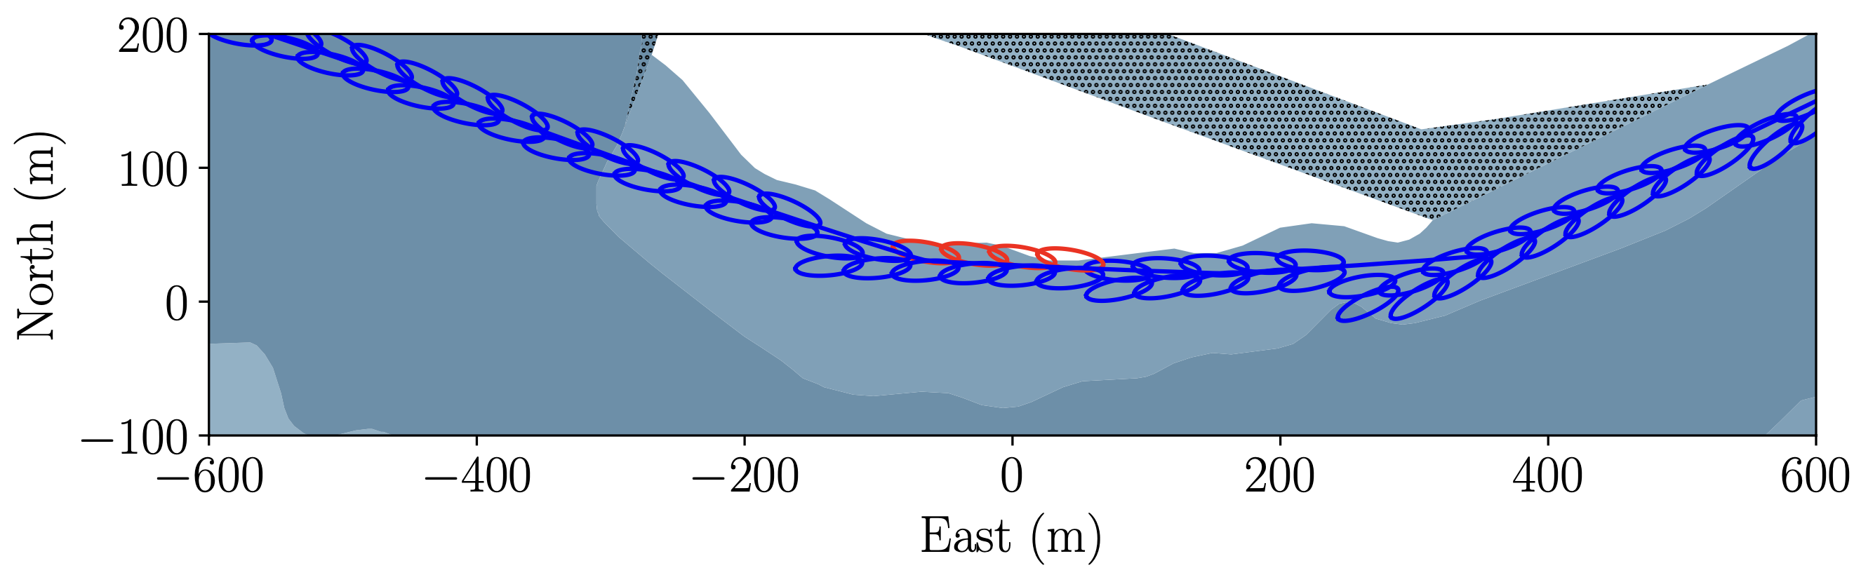
Manoeuvrability assessment (example)
Red ellipses are not fully contained within the navigable body of water
Notes:
This plot shows an example of the projected comfort zones for a predicted trajectory of a target vessel.
All blue ellipses are fully defined within the body of navigable water, whereas the red elipses indicate when the comfort zone is no longer fully within the navigable body of water.

Slide 13
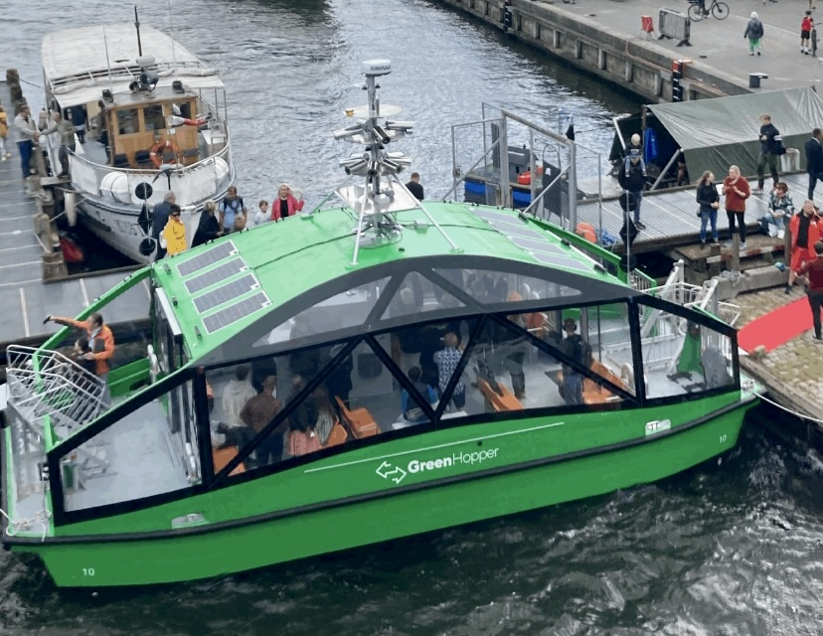
Simulation Scenarios
GreenHopper Harbour buss
Length: 11 meters
Draught: 0.5 meter
Capacity: 24 passengers
Route
Crossing the Limfjord
Nørresundby ←→ Aalborg (5-7min)
No draught restrictions
Notes:
When designing our simulation scenarios, we designed them around a specific usecase, namely the newly built GreenHopper.
The GreenHopper is a small harbour bus, the vessel is 11 meters long, and has the capacity to transport 24 people, some bikes and a wheelchair.
The greenhopper will be sailing back and forth across the Limfjord between Nørresundby to the north and Aalborg to the south, a passage which will take approximately 5-7 minutes
It should be noted that the draught of the GreenHopper is only approx. 0.5 meters, so the vessel can safely navigte anywhere in the area.
The harbour buss have been equipped with sensors and computers to enable fully autonomous operation, however, for now it will be sailing with a navigator onboard, who can take over in case of emergencies or other unforseen events.

Slide 14
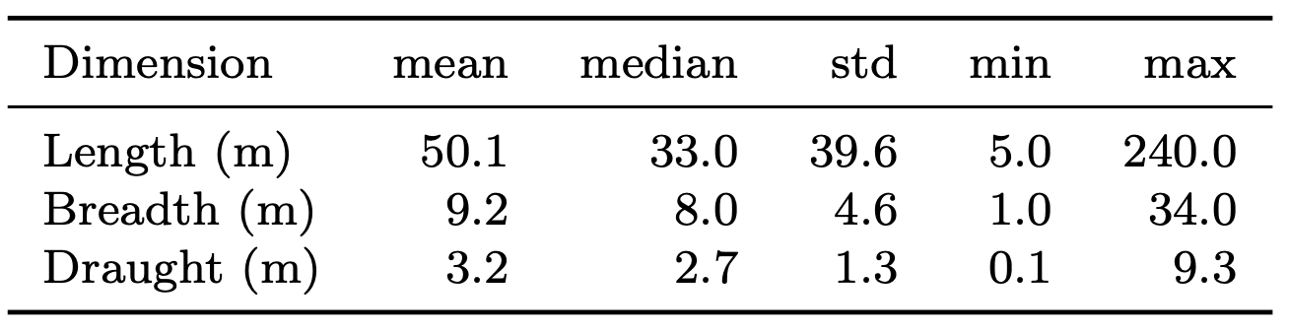
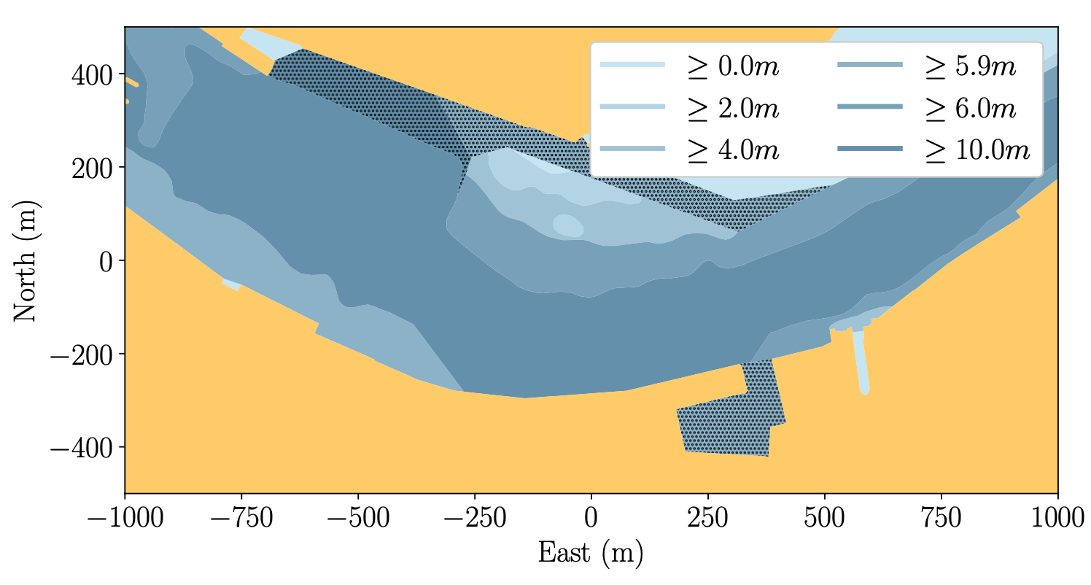
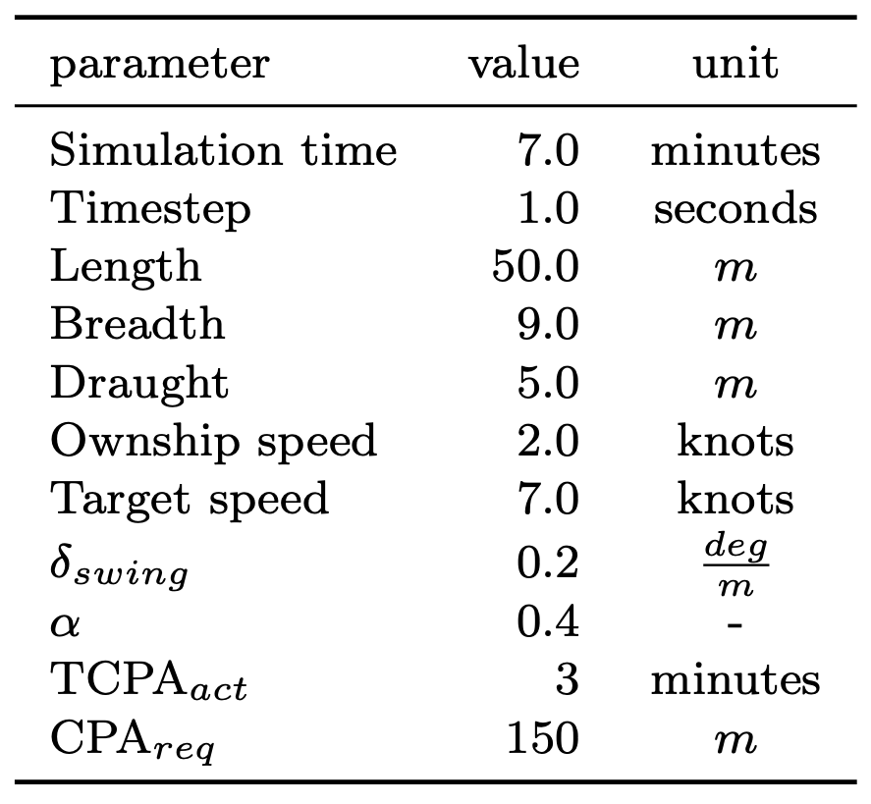
Simulation Scenarios
AIS Analysis
Parameters based on 2 years of AIS data in the region
Simulation Parameters:
Geographic area
Limfjorden in Aalborg
Crossing from north
Notes:
To ensure a somewhat realistic simulation scenario, we analysed the AIS data of all vessels in the area over a two year timeperiod.
The results are summarised in the table to the right
The bottom left table summarises all the parameters that we used for the simulation scenarios.
I dont want to bore you with numbers and tables, as not all of the parameters in this table are important, but I do want to highlight a few of them, and give you the motivation for our choices.
Based on the AIS analysis, we chose a length of 50 meters (CLICK NOW) for our target vessel, as this was the average length of all vessels.
However, for the draught, we arbitrarily chose a value of 5 meters, (CLICK NOW) as the average value of 3.2 meters, would not restrict the target in a sufficiently large area.
Also note, we have chosen a swing rate of 0.2, as this is a valid value for vessel of up to 200 meters of length, and coupled with an alpha value of 0.4 - this results in a rudder angle of approx. 15 degrees.
Lastly CPA and TCPA_act are set to 150 meters, and 3 minutes.
This means that the autonomous system will not perform any assessment untill 3 minutes before CPA.
The reason for this is that the vessel would otherwise start the assessment, deem the target to be restricted, and initiate a manoeuvre instantly.
This evasive manoeuvre might not be obvious to the target vessel, and could cause confusion.

Slide 15
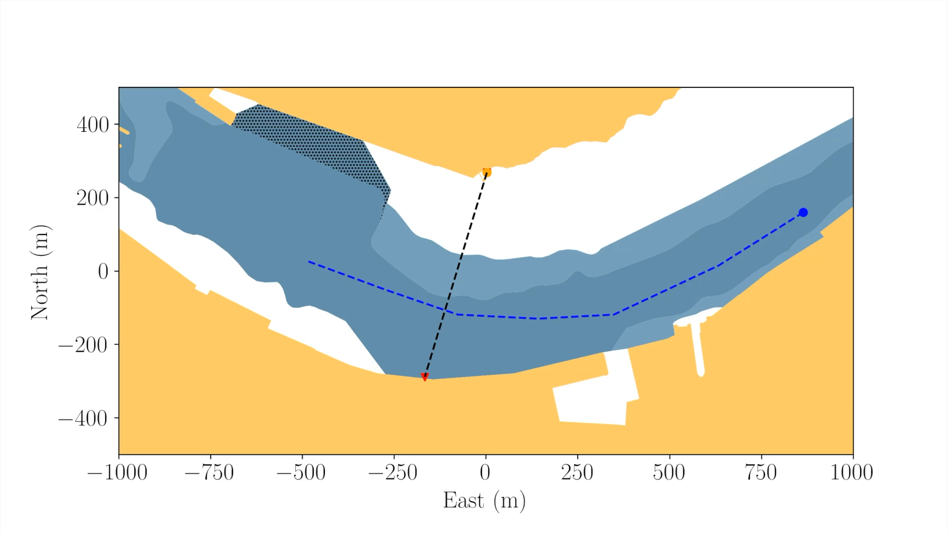
Simulation: Target not restricted
Notes:
Now lets take a look at a simulated example, where the target should not be considered restricted.
In this example, we have a ownship in orange sailing from north to south and a target vessel in blue saililng west.
This means we have a crossing scenario, where the target should give way to ownship as governed by rule 15.
Rember the target vessel has a draught is 5 meters, so we only show the depth contours that are navigable for the target, this means that the white areas are to shallow for the target to navigate in.
The dashed black line is the path between the waypoints, indicated by red triangles, that ownship should follow
The dashed blue line is the expected trajectory of the target vessel provided by the trajectory estimation algorithm.
So by looking at this, there should be enough space for the target to manoeuver, so rule 9 should not apply, hence target should give way to ownship.
So lets start the video and see what happens. We see that indeed, ownship does not move, meaning that rule 9 is not applied to this situation, and the target vessel is able to navigate around ownship without issue.

Slide 16

Simulation: Target restricted
Notes:
Now lets change the simulation a bit.
This scenario is similar to the previous one, however, we have
moved the target and its predicted trajectory futher north, such that it is sailing much closer to the shallow water area.
Remeber rule 9 dictates that a vessel should sail as close as possible to the channel on its starboard side.
This should mean that the target is not able to manoeuvre as freely as before.
Now if we start the video we can see what happens.
Here the system detects the collision risk, assess the manoeuvrability of the target to be restricted, and replans a trajectory around the target – inserting an extra waypoint.
Although it might not look like it, there is 50-60 meters of space between the vessels, which is plenty of space for a 11 meter long vessel!

Slide 17
Conclusions
Novel approach to assessing and implementing Rule 9
Developed a modular framework for future expansion
Implemented into an existing COLREGs framework (13-15)
Verified implementation in realistic simulation scenarios
Notes:
So what are our conclusions?
we have, to the best of our knowledge, developed the first Rule 9 compliant framework to support autonomous navigation at sea
We have also developed framework which is modular in its design, allowing for better methods for trajectory estimation and maneuverability assessment to be implemented in the future
We implemented the proposed framework into an already existing COLREGs compliant framework
Lastly we have validated our method in realistic simulation scenarios, based on a real-world use case.

Slide 18
Future work
Improve manoeuvrability estimates
Better behaviour models for prediction (on-going)
More granular manoeuvrability estimate (time-wise)
Test and verification on real hardware systems
Currently being implemented on GreenHopper
Notes:
For future work:
We would like to improve the manoeuvrability estimation scheme:
- this could be done by using learning based behaviour models, something that we’re currently pursuing
- And with these better behavioral models, we could be more precise in the manoeuvrability assessment, such that we “only” consider the manoeuvrability of a target vessel during the expected avoidance manoeuvre, and not along the entire predicted trajectory.
Lastly, we will be testing this implementation onboard the GreenHopper sometime next month, where we hope to demonstrate the applicability of our design.

Slide 19
Thank you for you attention!
Contact me via email: pnha@dtu.dk
Notes:
And with that, I would like to that you for your attention, and please feel free to reach out if you have any questions or have any collaboration ideas, thank you.

